Slide 1


CLASSIQ PROJECT
WOMANIUM QUANTUM + AI
Name : Suprajit Dewanji
Enrollment ID: WQ24-2pzu25nIdQibKOw

Slide 2
NOVEL QUANTUM
ALGORITHM DEVELOPMENT
Simulation of n-Coupled Harmonic Oscillator

Slide 3




CONTENTS
Defining the Problem Statement
Mathematical Defination and Workflow of the Algorithm
QMod Code, the Results and Conclusion

Slide 4
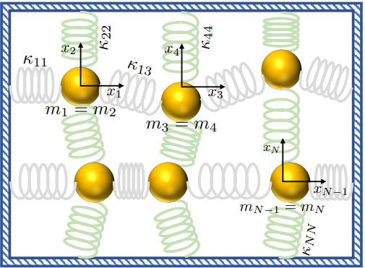
PROBLEM STATEMENT
The problem id to simulate a n-coupled harmonic oscillator using quantum algorithms
Problem is solved with a quantum algorithm that makes Q = O(τ + log(1/ϵ)) queries to the oracles for K and M, using G = O( Q × log^2( N*τ* mmax/ mmin*ϵ )) 2-qubit gates.

Slide 5

The system of n-coupled oscillator can be thought of
a undirected graph. Therefore the ‘Quantum Walk’ algorithm can be used to simulate the Hamiltonian of the system effectively.
WORKFLOW OF THE ALGORITHM
For this, the following steps can be followed:
Encoding of the Problem to a Quantum state with ‘mixing’ of all the vertices
2. Time evolution of the system to acheive the desired results

Slide 6
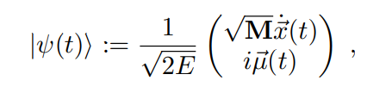
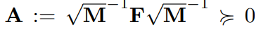
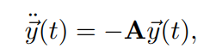
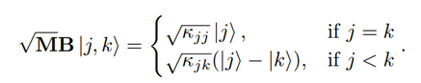
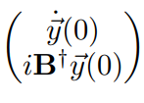
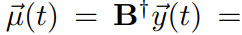
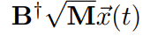
As per the below expression,
ENCODING THE PROBLEM
We can make a Unitary operator A such that
Therefore we can construct |psi(0)> in the following way:
Where |j> and |k> are 2 vertices of the graph
Therefore the problem reduces to the following:
With

Slide 7

First of all, we define the m_sqrt_gate() function and W_operator to encode the 1st part
@qfunc
def sqrt_mb_gate(j: Qbit, k: Qbit, kappas: QConstArray[]):
"""Implements the sqrt(MB) gate based on the given problem."""
for j in range(2**size):
if j == vertices:
# Case where j = k
amplitude = sqrt(K[j][j])
apply_amplitude_gate(amplitude, adjacent_vertices)
else:
# Case where j < k
amplitude = sqrt(K[j][vertices])
apply_amplitude_gate(amplitude, adjacent_vertices)
# Subtract from |k⟩ state
control(ctrl=adjacent_vertices == vertices,
operand=lambda: apply_phase_gate(-amplitude, adjacent_vertices))
@qfunc
def W_iteration(i:CInt,vertices: QNum, adjacent_vertices:QNum):
"""Modified iteration function with sqrt(MB) applied."""
prob = [0] * 16
if i == 0:
prob[1] = 1.0
elif i == 15:
prob[14] = 1.0
else:
prob[i - 1] = 0.5
prob[i + 1] = 0.5
# Assuming K is predefined with appropriate spring constants
K = [...] # Placeholder for actual spring constant values
control(ctrl=vertices == i,
operand=lambda: within_apply(
compute=lambda: inplace_prepare_state(probabilities=prob, bound=0.01, target=adjacent_vertices),
action=lambda: sqrt_mb_gate(vertices, adjacent_vertices, K)))
@qfunc
def W_operator(vertices:QNum, adjacent_vertices: QNum):
"""Applies the W operator for the quantum walk."""
for i in range(2**size):
W_iteration(i, vertices, adjacent_vertices)
CODE FOR THE ENCODING
Next we do the encoding of the velocity component or more precisely the kinetic energy component and merge the two functions to get the initial encoding
size = 4
# Assuming sqrt_M and B_dagger are precomputed
sqrt_M = np.array([...]) # Replace with the computed sqrt(M) matrix
B_dagger = np.array([...]) # Replace with the computed B^\dagger matrix
@qfunc
def prepare_velocity_state(vertices: QNum, sqrt_M):
for i in range(vertices.size):
amplitude = sqrt_M[i] # Use sqrt(M) for initial velocity state
apply_amplitude_gate(amplitude, vertices[i])
@qfunc
def prepare_displacement_state(vertices: QNum, B_dagger):
for i in range(vertices.size):
amplitude = B_dagger[i] # Use B^\dagger for displacement state
apply_amplitude_gate(amplitude, vertices[i])

Slide 8

We will be using the continous-time quantum walk algorithm
This means we will be having
exp(-i*H*t) as the time evolution operator
exp(-iHt) can be written as cos(t)*I - i* sin(t)*H
TIME EVOLUTION
import numpy as np
from classiq import QNum, RZ, RY
def apply_unitary_gate(amplitude: complex, vertices: QNum):
"""Applies a unitary gate with the given amplitude to the vertices qubit register."""
angle = np.angle(amplitude) # Phase component
magnitude = np.abs(amplitude) # Magnitude component
RZ(vertices, angle) # Apply phase shift
RY(vertices, 2 * np.arcsin(magnitude)) # Apply rotation for magnitude
def apply_hamiltonian_step(vertices: QNum, h_value: float, t: float):
"""Apply a single step of the Hamiltonian evolution."""
cosine_term = cos(t)
sine_term = -1j * sin(t) * h_value
apply_unitary_gate(cosine_term, vertices)
apply_unitary_gate(sine_term, vertices)
@qfunc
def apply_time_evolution(vertices: QNum, t: CReal):
"""Apply the time evolution operator exp(-iHt) to the quantum state."""
for j in range(2**size):
h_value = H_value(j, vertices)
apply_hamiltonian_step(vertices, h_value, t)

Slide 9
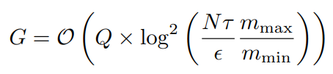
CONCLUSION
Therefore we simulate a n-coupled oscillator using Quantum algorithms by reducing the oscillator problem in energy basis and graph data structure. This enables us to use the quantum walk algorithm to simulate it efficiently thus providing an exponential speed up in the simulation by using
Q = O(τ + log(1/ϵ)) queries to K and M oracles (that gives Mass and spring constants respectively) with the use of
number of gates.

Slide 10
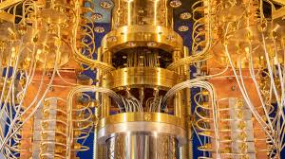
THANK YOU

